Slide 1
Online Event-driven Subsequence Matching over Financial Data Streams
Huanmei Wu, Betty Salzberg, Donghui Zhang
Northeastern University,
College of Computer & Information Science
Presented by : Evangelos Kanoulas

Slide 2
Motivation (1)
An incoming stream of stock market data
Analyze it and do
  Trend prediction
  Pattern recognition
  Dynamic clustering of multiple data streams
  Rule discovery
Subsequence matching is the main component

Slide 3
Motivation (2)
Subsequence similarity over financial data streams has its unique properties
    Zigzag shape of piecewise linear representation (PLR)
    Relative position of end points is important
    Price change (amplitude) is more important than time interval
S₁
Price
S₂
Price
S₁
S₂
S₃
4
4’
2
2’
5
5’
1
3
1’
3’
time
time

Slide 4
Outline
Motivation
Data Stream Processing
Subsequence Matching
Trend Prediction
Performance
Conclusion

Slide 5
Data Stream Processing (1)
Aggregation and Smoothing
Incoming data arrives at any time
Piecewise Linear Representation requires a unique value for each time interval
Aggregation of the raw data
Smoothing of the aggregated values using the moving average

Slide 6
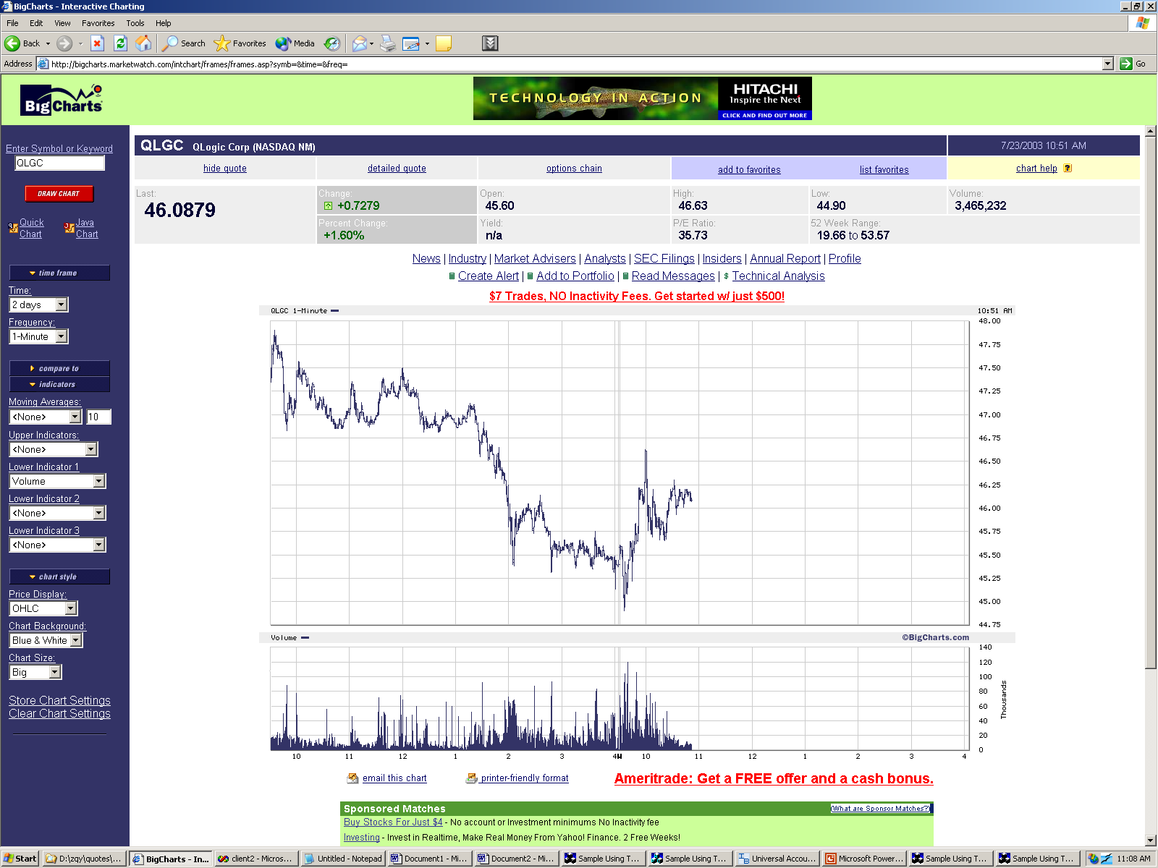
Data Stream Processing (2)
Segmentation
aggregated data stream
PLR may not be in a zig-zag shape
The end points of the PLR should be points at which the trend changes dramatically
All other points are considered as noise and should be eliminated

Slide 7
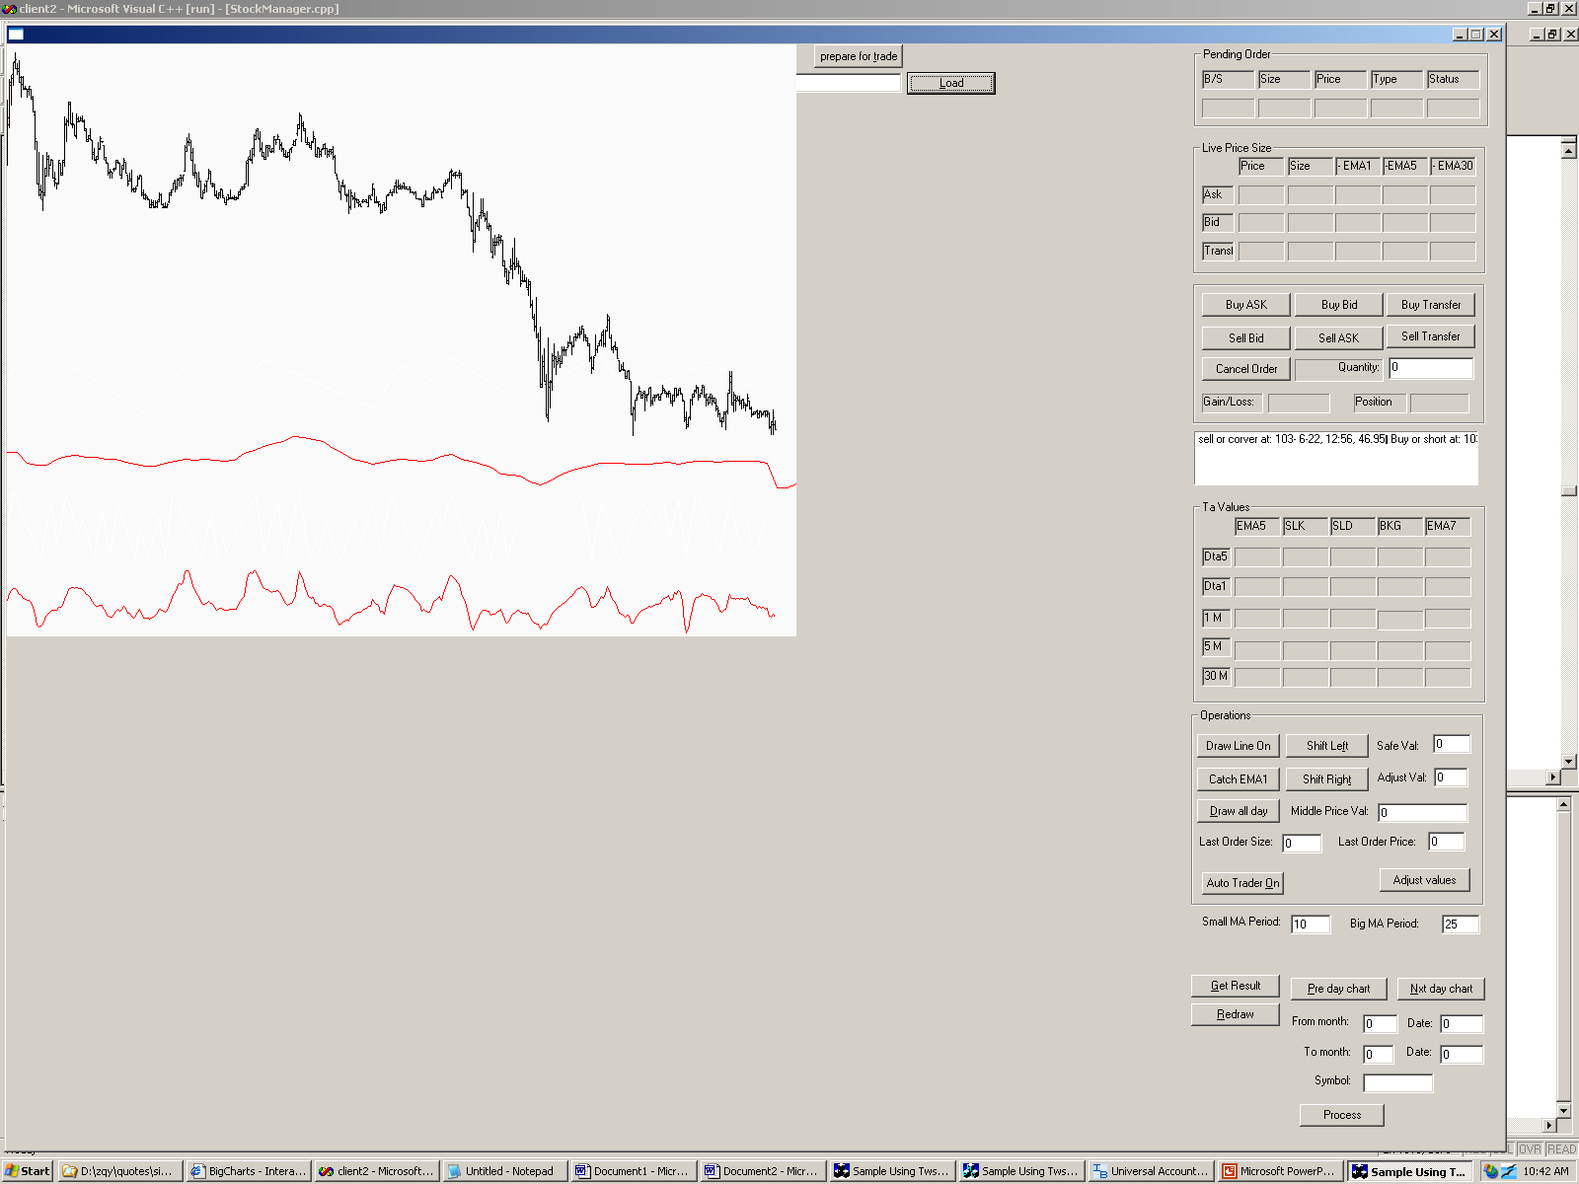
Data Stream Processing (3)
%b data stream : the base for linear segmentation
Why use %b (Bollinger Band Percent)?
%b is a widely used financial indicator
%b has a smoothed moving trend similar to the aggregated data stream
%b is normalized value, most values are between -1 and 2
➔Uniform segmentation criteria
aggregated data stream
%b data stream

Slide 8
Data Stream Processing (4)
Segmentation over %b
P_{i}
8
9
10
12
Price (x)
7
δ
11
13
1
6
P_{j}
2
4
5
3
Sliding Window
t
In the current sliding window, where P_{j}(X_{j},t_{j}) is the current point, P_{i}(X_{i}, t_{i}) is an upper end point if,
X_{i} = max ( X values of the current sliding window )
X_{i} > X_{j} + δ ( where δ is the given error threshold )
P_{i}(X_{i}, t_{i}) is the last one satisfying the above two conditions

Slide 9
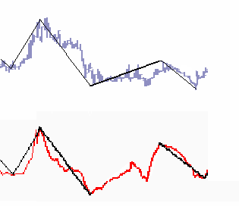
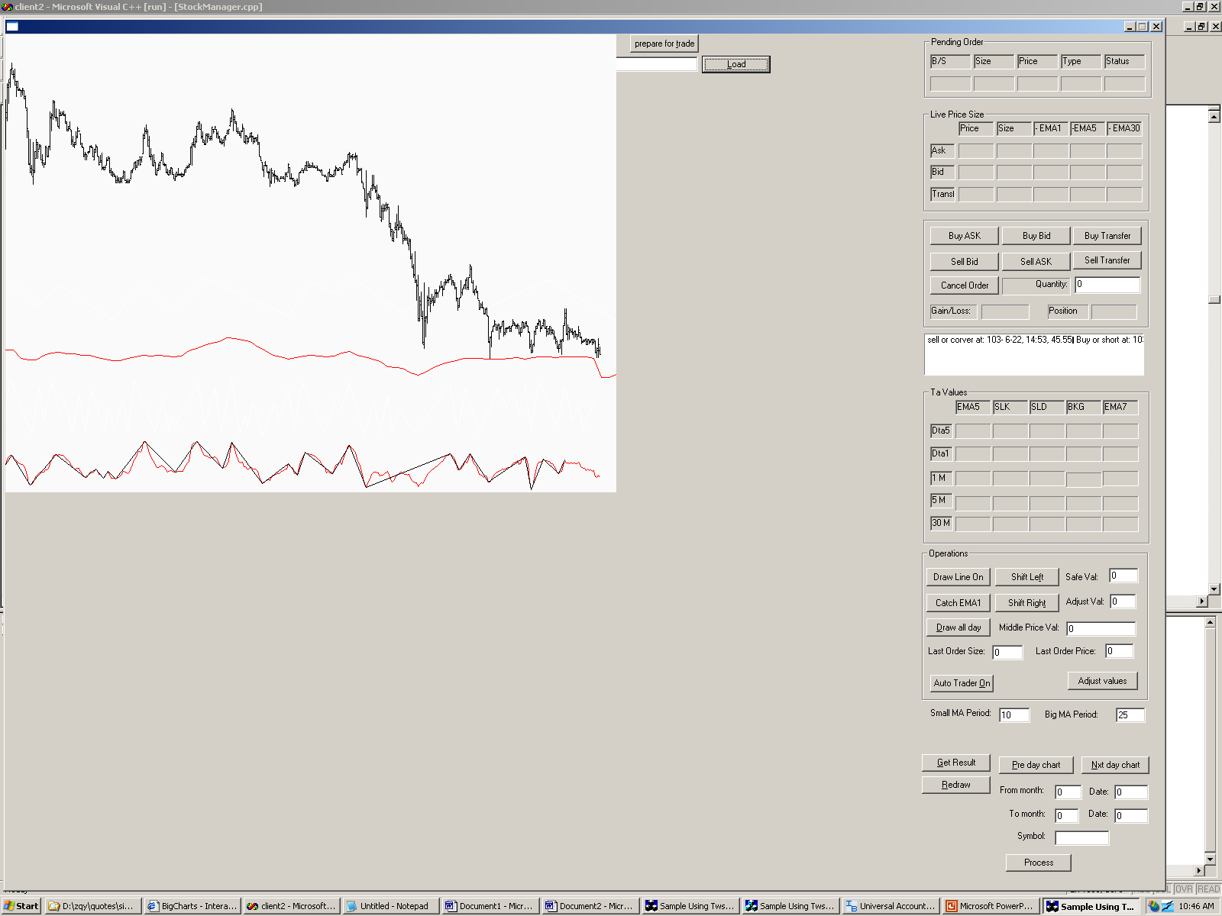
Data Stream Processing (5)
Two Step Pruning
price
price
Agg. Stream
δ_{p}^{d}
%b stream
δ_{p}^{b}
δ_{p}^{b}
t₀
t₁
t₂
t
t₃
t₄
t₀
t₁
t₂
t₃
t₄
t₅
Filter step on %b streams
Refine step on the raw sequence stream to eliminate false positives

Slide 10
Outline
Motivation
Data Stream Processing
Subsequence Matching
Trend Prediction
Performance
Conclusion

Slide 11
Subsequence Similarity (1)
Event-driven subsequence matching
Identifying a new potential end point triggers a subsequent matching search
The search algorithm finds subsequences in the historical data similar to a query subsequence
The query subsequence consists of the most current n end points
Price
4
2
1
3
t
t₅ t₆ t₇ t₈ t₉ t₁₀ t₁₁ t₁₂ t₁₃ t₁₄ …… t₃₇ t₃₈ t₃₉ t₄₀

Slide 12
Subsequence Similarity (2)
New similarity measure
S = {(X₁, t₁), (X₂, t₂), …, (X_{n}, t_{n})}
S' = {(X₁', t₁'), (X₂', t₂'), …, (X_{n}', t_{n}')}
S and S' are similar if they satisfy the following two conditions :
The relative position of S and S' end points is the same
d(S, S') < γ, where
  d(S, S') = (α * Σ ||(X_{i+1} - X_{i})| - |(X_{i+1}' - X_{i}')||
  + β * Σ |(t_{i+1} - t_{i}) - (t_{i+1}' - t_{i}')|)
  where α, β, γ ≥ 0 are user defined parameters

Slide 13
Subsequence Similarity (3)
Subsequence Permutation
S = {(X₁, t₁), (X₂, t₂), …, (X_{n}, t_{n})}
Separate upper and lower points
S’ = { [(X₁, t₁), (X₃, t₃), …, (X_{n-1}, t_{n-1})],
[(X₂, t₂), (X₄, t₄), …, (X_{n}, t_{n})] }
Sort separately based on X values
S” = {[(X_{i1}, t_{i1}), (X_{i3}, t_{i3}), …, (X_{i(n-1)}, t_{i(n-1)})],
[(X_{i2}, t_{i2}), (X_{i4}, t_{i4}), …, (X_{in}, t_{in})] }
Get the subsequence permutation
{i₁, i₃, …, i_{(n-1)}, i₂, i₄, …, i_{n}}

Slide 14
Outline
Motivation
Data Stream Processing
Subsequence Matching
Trend Prediction
Performance
Conclusion

Slide 15
Trend prediction
Subsequence matching application
Trend-K at a point p measures the change of the price to the next k points
Three trends: UP, DOWN, NOTREND
Price
ε
t
t₅ t₆ t₇ t₈ t₉ t₁₀ t₁₁ t₁₂ t₁₃ t₁₄ …… t₃₇ t₃₈ t₃₉ t₄₀

Slide 16
Outline
Motivation
Data Stream Processing
Subsequence Matching
Trend Prediction
Performance
Conclusion

Slide 17
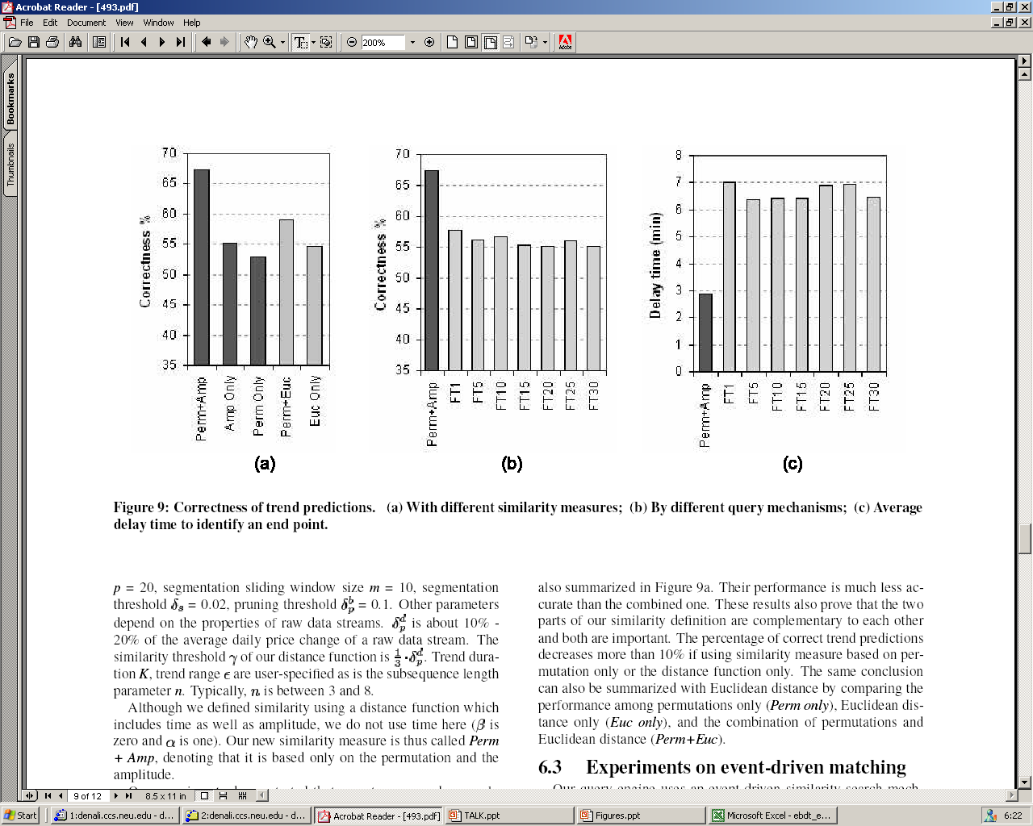
Performance (1)
Similarity measure
70
65
60
55
50
45
40
35
30
Correctness %
Perm+Amp
Amp Only
Perm Only
Perm+Euc
Euc Only

Slide 18
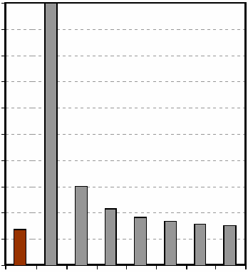
Performance (2)
Event–driven vs. Fixed time periods
70
65
60
55
50
45
40
35
30
100%
90%
80%
70%
60%
50%
40%
30%
20%
10%
0%
Relative CPU cost
Correctness %
FT1
FT10
FT25
FT5
FT15
FT1
FT20
FT30
FT5
FT10
FT15
FT20
FT25
FT30
Event-driven
Event-driven

Slide 19
Outline
Motivation
Data Stream Processing
Subsequence Similarity
Trend Prediction
Performance
Conclusion

Slide 20
Conclusion
Proposed an online segmentation and pruning algorithm
Defined an alternative similarity subsequence measure
Introduced an event-driven online similarity matching algorithm
Achieved 70% correct predictions using real world data

